Slide 1
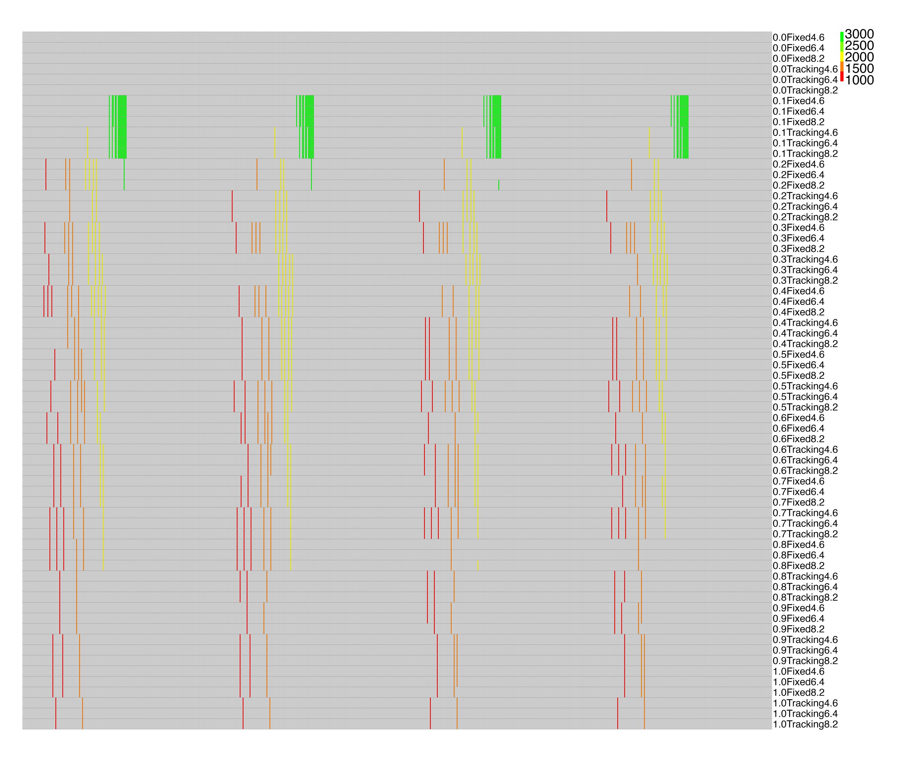
Northern AL
Central AL
Black Belt AL
Southern AL
Gp_sbavp_wocp.png

Slide 2
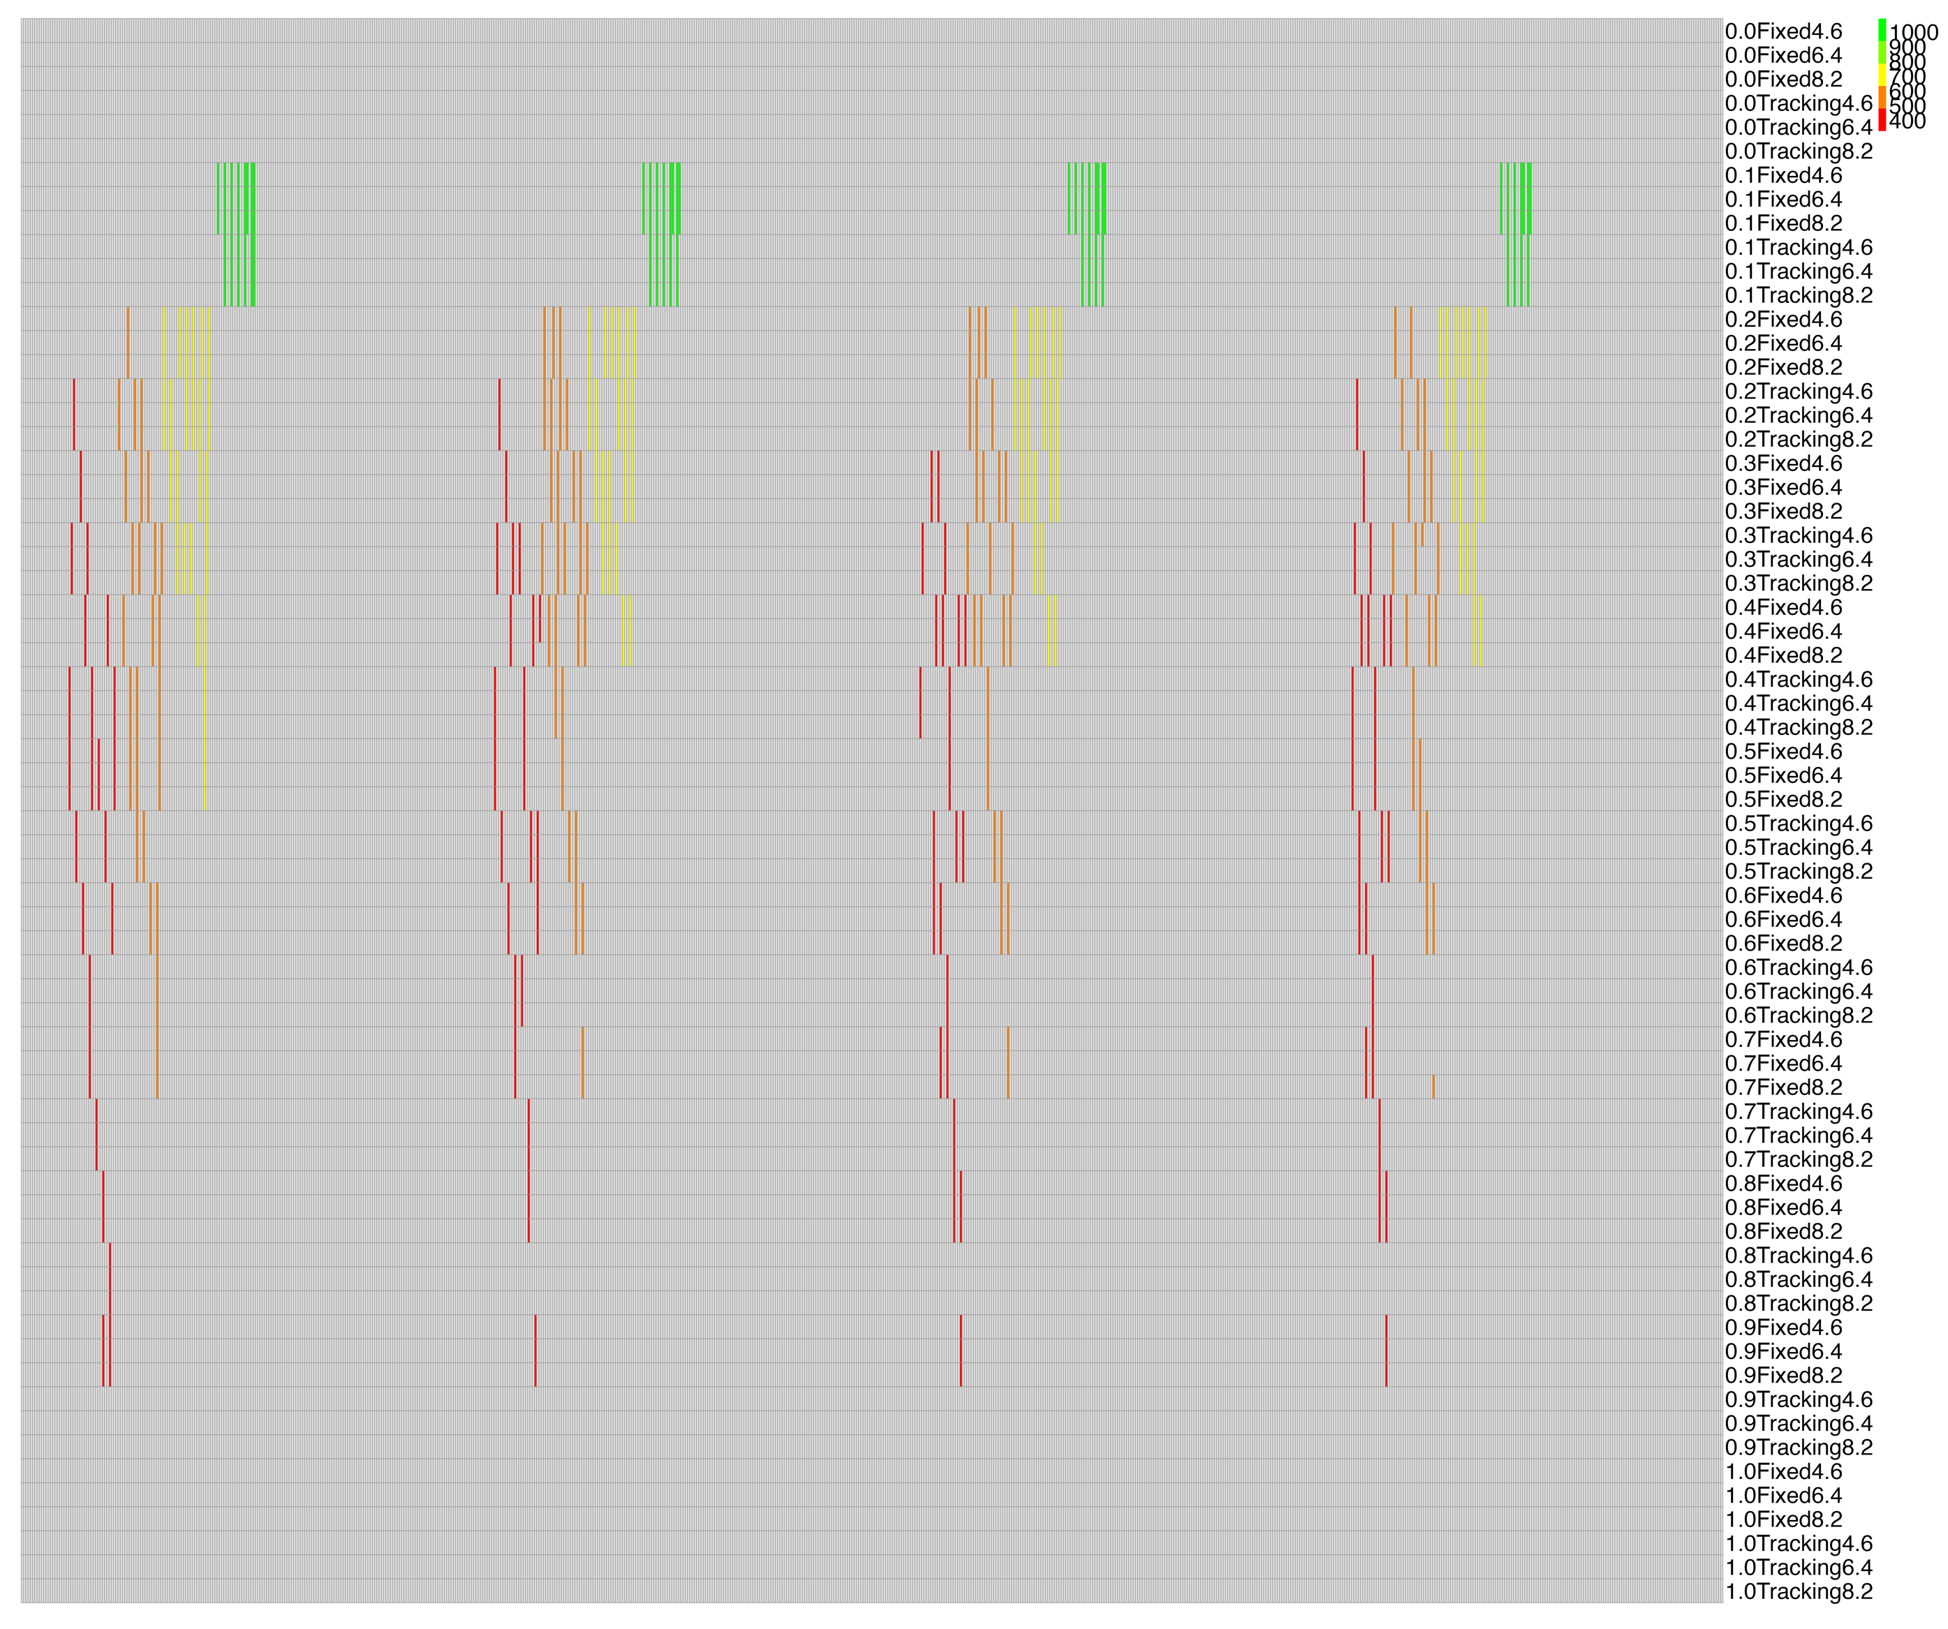
Northern AL
Central AL
Black Belt AL
Southern AL
Gp_sqavp_wocp.png

Slide 3
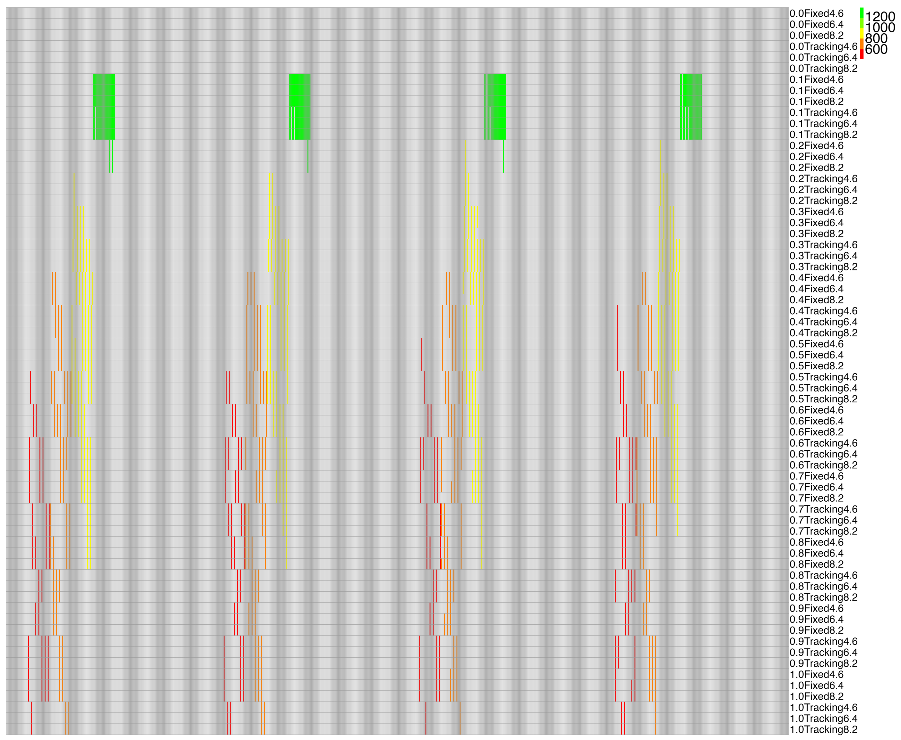
Northern AL
Central AL
Black Belt AL
Southern AL
Gp_tavp_wocp.png

